Slide 1
Shell Bootcamp 2024 3 Reflections for Week #2
Shambhavi Vats
Date : 6 september-2024

Slide 2

About Me
Fuelling my passion for tech and growth with hard work and a good meal.

Slide 3

My learnings from this week!

Slide 4
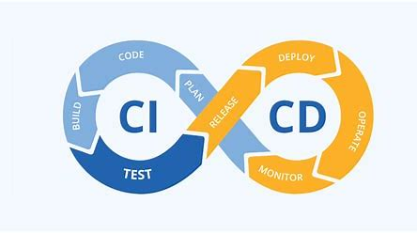
Learning 1 | My takeaways
Key Learning
CI/CD automates the integration and deployment of code changes, making software delivery faster and more reliable.
Key Takeaway
CI/CD helps detect issues early and deploy updates quickly, improving efficiency and reducing manual errors.
Implementation in the Energy Sector
CI/CD can streamline updates to energy management systems, enhancing efficiency, reliability, and security in managing energy resources.

Slide 5
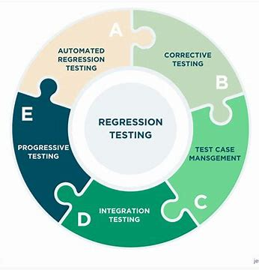
Learning 2 | My takeaways
Key Learning
Regression Testing involves re-running existing tests to ensure new code changes haven't negatively impacted existing functionalities.
Key Takeaway
This practice helps maintain software stability and reliability by identifying any issues introduced by recent updates.
Implementation in the Energy Sector
In the Energy sector, regression testing ensures that updates to energy management systems or control software don’t disrupt critical operations, maintaining system stability and performance.

Slide 6
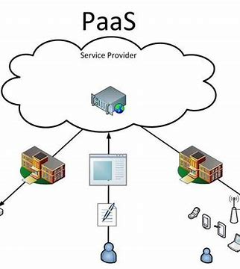
Learning 3 | My takeaways
Key Learning
PaaS offers a cloud environment with tools for developing, testing, and deploying applications.
Key Takeaway
It simplifies development by managing infrastructure, allowing developers to focus on code.
Implementation in the Energy Sector
PaaS supports scalable solutions for real-time monitoring and data analysis in energy systems, reducing the need for extensive infrastructure.

Slide 7

Relevance of learnings for my organization

Slide 8
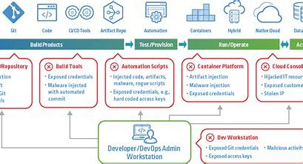
Learning 1 | Relevance for Shell
How Shell Implements CI/CD
Shell uses CI/CD to automate and streamline their software development. This approach ensures that code changes are tested and deployed quickly and reliably. It helps manage large-scale projects efficiently and keeps their systems up-to-date.
How Shell Benefits from CI/CD
CI/CD reduces deployment times, enhances software reliability, and minimizes errors. This leads to faster delivery of new features and innovations. It also improves operational efficiency and supports the robustness of critical energy systems.

Slide 9
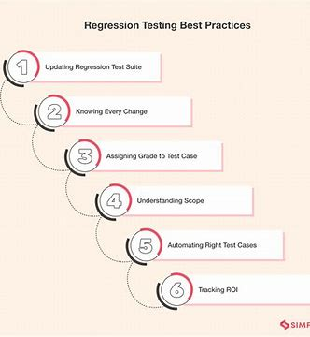
Learning 2 | Relevance for Shell
How Shell Implements Regression Testing
Shell incorporates regression testing to verify that new software updates or changes haven’t disrupted existing functionalities. By re-running previously successful tests, they ensure that their systems remain stable and reliable even as new features are added.
How Shell Benefits from Regression Testing
Regression testing helps Shell maintain the stability of their software by catching issues that might arise from updates. This practice minimizes disruptions in critical systems, ensuring smooth operations and reducing the risk of downtime or failures.
¯

Slide 10
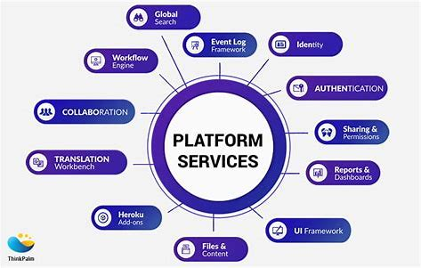
Learning 3 | Relevance for Shell
How Shell Implements PaaS
Shell utilises PaaS to develop, deploy, and manage applications in the cloud, streamlining operations without the need for extensive on-premises infrastructure.
How Shell Benefits from PaaS
PaaS allows Shell to scale applications easily, reduce infrastructure costs, and accelerate development, improving overall efficiency and flexibility in managing energy systems.

Slide 11

Challenges in implementing learning

Slide 12
Challenge faced while implementing Learning 1
CI/CD
Challenges Faced:
Integration Issues: Difficulty in integrating new code with existing systems and ensuring compatibility.
Automation Setup: Challenges in configuring and managing CI/CD pipelines effectively.
Plan to Overcome:
Incremental Integration: Use feature flags and gradual rollouts to manage changes smoothly. Leverage Tools: Invest in and utilize robust CI/CD tools and frameworks to streamline automation.

Slide 13
Challenge faced while implementing Learning 2
Regression Testing
Challenges Faced:
Test Coverage: Ensuring all essential features are included in regression tests.
Execution Time: Managing the time required to run a comprehensive suite of tests.
Plan to Overcome:
Automate Testing: Use automated testing tools to maintain and run tests efficiently.
Prioritize Tests: Focus on critical and high-impact tests to optimize execution time.

Slide 14
Challenge faced while implementing Learning 3
PaaS
Challenges Faced:
Cloud Complexity: Understanding and managing the diverse services and features of cloud platforms.
Cost Management: Controlling and optimizing expenses associated with cloud resources.
Plan to Overcome:
Training and Support: Invest in cloud training and support to navigate complexities.
Monitor and Optimize: Regularly review cloud usage and costs to ensure efficient resource management.

Slide 15

Action Plan

Slide 16
My Action Plan for this Week
Actions
Timeline
Status
1. Trying to implement CI/CD pipeline on github actions
2. Using Fitnesse for unit test case
To be completed by the end of the week
In progress , I have started to learn and implement the learning

Slide 17

Learning is also Fun!

Slide 18
Learning is also Fun!
We tried a lots of hands on activity to implement the learning during this week . The hand on was very fun and engaging

Slide 19

Summary
Learned and implemented devops , CI/CD, testing , database concepts
Next week we have important session on front end and dot net development
This week learning will help me better understand the upcoming topics

Slide 20
Thank You

